Slide 1
Customer Analytics
Yann Gouedo
Data Scientist Leader – Machine Learning / Artificial Intelligence
Marketing / Risk / Fraud / Maintenance
IBM Certified Senior Data Scientist & IBM Certified Senior Architect

Slide 2
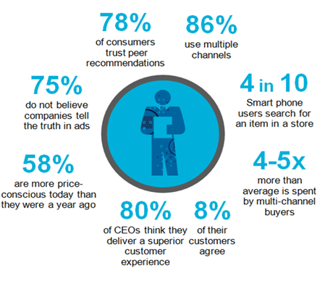
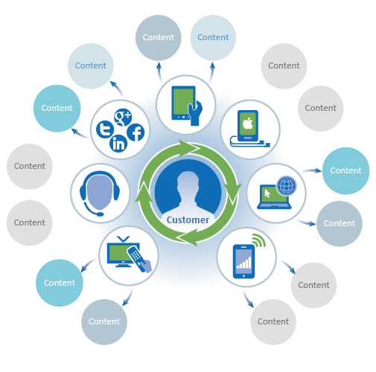
Getting closer to consumers is top priority for all B2C companies
Organizations have two seconds to connect with a customer
Increasingly empowered consumer
Unlimited access to information, ability to share experiences instantaneously
Raised expectations of product, service, delivery because of global competition
Changed dynamic between buyer and seller because of multichannel ability
Limited organizational insight
Unable to use knowledge of past and present events to increase customer value
Incomplete view of customer at time of interaction
Inconsistent delivery of service resulting from a lack of visibility across organizational silos
Notes:
Today’s customers are well-informed and empowered by information: 78% of consumers trust peer recommendations, 86% use multiple channels, …
To serve these empowered customers, the business must — now more than ever — put them at the center of everything you do. Consumers expect you to know them, service them exactly as they prefer, be proactive about their customers’ needs, requirements, have this insight available in real-time and insure that all interactions are of high value and the customer is understood through multiple perspectives – not simply the date of the contract expiration.
The ability to attract, retain and satisfy them now and into the future requires providing the right experience at the right time for each individual customer.
The pains of companies are multiple as the following:
They do not use the knowledge of past and present events to increase customer value
They do not have the complete view of a customer at time of interaction
They do not have the consistent delivery
Digital transformation forces are changing the nature of how individuals and organizations interact, creating an individual-centered economy
Social media adoption is prevalent, and is connecting people globally
Mobile revolution has miniaturized computing power and changed how and where consumers interact
Powerful analytics bring deep consumer intelligence and business optimization
Cloud enablement drives new business models
As digital transformation and the individual-centered economy is impacting impacts all levels of business and society, creating a set of opportunities and challenges for businesses.
Individuals are more connected and empowered, leading to rising expectations around access, ubiquity, and transparency .
Competition is coming from new and different areas, opening up opportunities for new entrants while creating new threats.
Organizations are adapting new business models and leveraging digital capabilities to enable new consumer experiences.
We are moving from an organization-centered economy that started in the 1930’s and progressed through to the 1980’s. In the 1990’s, the development of digital capabilities and rising consumer expectations have resulted in the emergence of an individual-centered economy that we are experiencing today.

Slide 3
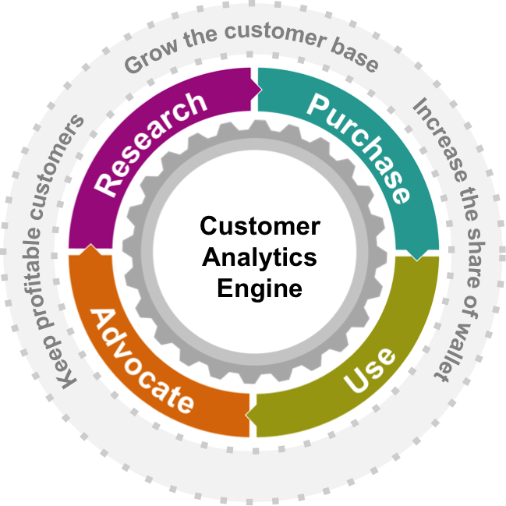
Following the customer journey
Track & understand consumer behaviors by identifying and monitoring the best offer, time, and channel while delivering info during research
Anticipate consumer
needs & desires while delivering the right offer by understanding the triggers and influence leading to purchase decisions
Track, monitor, influence & analyze consumer sentiment, engage advocates leveraging social & internal data to promote loyalty and advocacy
Provide personalized and proactive customer service, connect users to peers, engage in conversations to establish early in the lifecycle

Slide 4
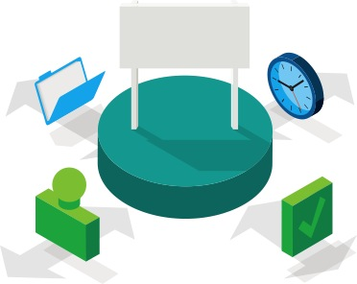
Analytics-driven organizations are distinguished by their ability to leverage
All information
Transaction/POS data Social data
Click streams
Surveys
Enterprise content
External data (competitive, environmental, etc.)
All perspectives
Past (historical, aggregated)
Present (real-time, scenarios)
Future (predictive, prescriptive)
At the point of impact
All people
All departments
Front line, back office
Executives, managers Employees
Suppliers, customers and consumers
Partners
All decisions
Major and minor
Strategic and tactical
Routine and exceptions
Manual and automated

Slide 5
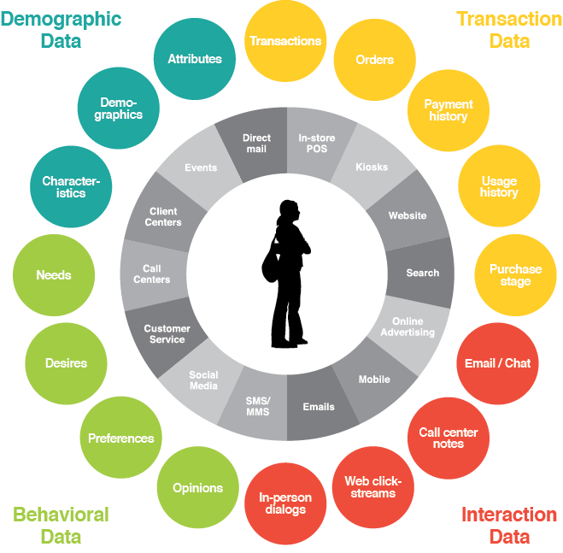
Customer Analytics – data types and sources

Slide 6

Turning customer data into business insights
Lifetime Value
Attitudinal
Acquisition/ Retention Cost
Average monthly spend
Social Value
Operational cost (call center usage, change of services)
Aggregated months in contract to date, months left in contract
High-value, dynamic - source of competitive differentiation
Services adoption
Service preferences
Current interests
Attitudinal Data
Needs
Tastes
360 degree
Satisfaction
Experience
Customer channel interaction
Price of services
Choice of services
Information and support
Flexibility of service provided
Experience with brand set expectations
Customer View
Network Quality experience (Coverage, latency, success of usage)
Customer channel experience (call center, payment, on-line, retail)
Consistency of experience
Historical
Transactional
Customer attributes (Age, Sex)
(Geo) Demographics
Contract type, longevity, history
Device type and usage
Payment History & Type, Credit rating
Product purchased, orders
“Traditional”
Services Types (preferred services, services not used)
Individual service usage (how often, how long, spikes, international)
Consistency of usage
Uptake of services and promotions.

Slide 7
Customer journey – coordinated experience
Marketing
Social Intelligence
Research
Product
Sales
Advocate
Product
Up/Cross
Sold
Purchase
Product
Get Customer
Service
Use
Product
Feedback Management
Support/Services
Notes:
7

Slide 8





Buyers are hungry for an integrated, personalized shopping experience
Single Engine for Engagement
CUSTOMER
CONTEXT
COMMERCE
Identify current needs, motivations and interactions – including their community of influencers -
predict and deliver next best offer
Discover unique groups or individuals based on their past purchases, preferences, motivations and interactions
CONTENT
Deliver personalized, meaningful, timely offers that meet immediate needs
COMMUNITY

Slide 9

Turning customer insight into action with analytics
Gain a deep understanding of customer segments, micro-segments, individuals
CUSTOMER
Customer
Segmentation
360 View
Of
Customer
Predictive Modeling
Detect patterns
Find preferences
Identify drivers
Predict demand
Score results
Model scenarios
Connect all touch points
Create 360 view
Analyze historic activity
Explore all data

Slide 10

Turning customer insight into action with analytics
Add context with historical sales data to understand product affinity, propensity to purchase and market basket analysis
CUSTOMER
CONTEXT
Customer
Segmentation
360 View
Of
Customer
Reporting and KPIs
Historic data
Present data
Suggested future behavior
Real-time
Decisions
Predictive Modeling
Combine history with current activities
Add other relevant external data (weather, demographics)
Add other relevant internal data (stock position, call center)
Identify behavioral drivers
Determine propensity to respond
Scoring – individuals not interested in everything equally!

Slide 11

Turning customer insight into action with analytics
Integrate social media data to understand purchase influencers and behavior
CUSTOMER
CONTEXT
Customer
Segmentation
360 View
Of
Customer
Reporting and KPIs
Historic data
Present data
Suggested future behavior
Real-time
Decisions
Predictive Modeling
Social communities
Retailer associates
Influencers
Known / unknown
COMMUNITY

Slide 12
Personalize shopping experiences with analytics
Customize experience and interactions by understanding what drives, enhances, and shapes purchase decisions
CUSTOMER
CONTEXT
Customer
Segmentation
360 View
Of
Customer
Reporting and KPIs
Historic data
Present data
Suggested future behavior
CONTENT
Real-time
Decisions
Personal Interactions:
Actions Offers
Predictive Modeling
Product assortment
Inventory levels
Relevant promotions
Continuous, meaningful dialogue
COMMUNITY

Slide 13

Personalize shopping experiences with analytics
Simplify purchase process by enabling anytime, anywhere exchange of money for goods
CUSTOMER
CONTEXT
Customer
Segmentation
360 View
Of
Customer
Reporting and KPIs
COMMERCE
Historic data
Present data
Suggested future behavior
CONTENT
Real-time
Decisions
Personal Interactions:
Actions Offers
Predictive Modeling
Conduct transaction
Exchange money for goods or services
COMMUNITY

Slide 14
Personalize shopping experiences with analytics
Measure key metrics at every step and use to continuously refine experience
CUSTOMER
CONTEXT
Customer
Segmentation
360 View
Of
Customer
Reporting and KPIs
COMMERCE
Historic data
Present data
Suggested future behavior
CONTENT
Real-time
Decisions
Personal Interactions:
Actions Offers
Predictive Modeling
COMMUNITY
Measure and analyze all touches, interactions, responses to refine approach

Slide 15



Understand customer behaviors to build strategy … use 360 view of performance, new data / criteria to increase marketing effectiveness
Traditional Approach
Superior Approach
Models based on few dimensions – demographics, purchase history or basket analysis
Same approach for every business – lacking industry and business model customization
Difficult to operationalize
Models based on many dimensions of customer behavior
Tailored to your business & value props
Designed for operationalization & personalization
Most segmentation approaches have two or three dimensions:
Multi-dimensional approach, based on customers behavior and response:
Product Style Preference
“…. consumers leave ‘bread crumbs’ of data — with intent when they opt in; in passing as they digitally browse, compare, and shop; and anywhere they use smart phones and media tablets.”
Sensitivity to Markdown Levels
Preferred Channel
Sales
Engagement Loyalty Program
Income
Age
Recency + Frequency + Value
Transactions
Response to Media
Use of own brand Credit Card
Latest & Greatest
Price Focused
Value Maximizers
Clearly Convenience
Geography
Estimated Time until Next Arrival
Use of Service Departments
Breadth of Entities Shopped
Return / Exchange Behavior
Basket Analysis
http://www.imagesfashion.com/pdf/6/ibm-user%20anakysis.PDF
Notes:
http://www.imagesfashion.com/pdf/6/ibm-user%20anakysis.PDF
IDC Report
15

Slide 16
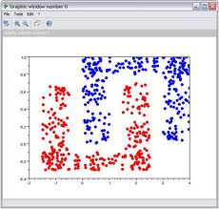
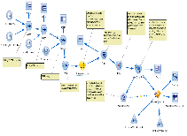

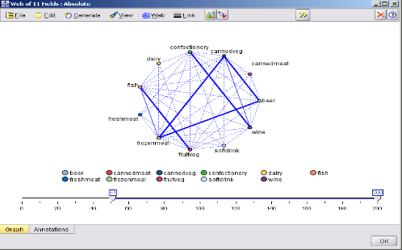
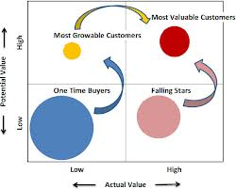
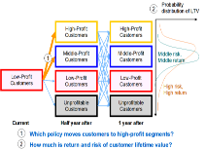
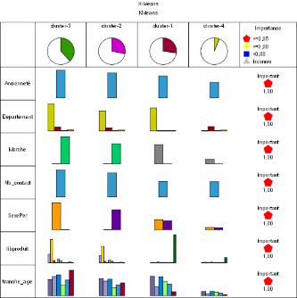
Advanced Analysis to increase marketing effectiveness
Churn Modeling,
Next Best Offer
Demographic segmentation
Real-time decision management
Market Basket Analysis
Customer Value Calculation
Banking
Product Affinity, Churn, Credit Card Default, Customer Segmentation
Insurance
Churn, Propensity to Buy, Campaign Response, CLTV, Customer Segmentation
Telecommunications
Product Association, Churn, Campaign Response, Satisfaction, Sentiment
Retail
Product Affinity, Customer Segmentation, Market Basket Analysis, Price Sensitivity, Campaign Response
Loyalty Segmentation
Notes:
Examples of different use case models.
Predictive analytics. Predictive analytics capabilities include data mining and modeling to help you anticipate what individual customers are likely to want or do next.
Decision management. Convert predictive scores into the most appropriate business action.
Real-time scoring. Real-time scoring generates and regenerates predictions on demand so you can immediately react to new information.
Customer lifetime value segmentation. Action recommendations are optimized for long-term expected reward.
Cross-campaign optimization. Scanning multiple campaigns, channels and business constraints enables the best assignment of customers to campaigns.
Closed loop analysis. Recommended actions, actual outcomes and new business experiments are fed back into the analytical process to help you continuously improve predictions and recommendations.
Analytical process automation. The automation of most analytical tasks helps increase reliability and consistency.

Slide 17


Next Best Offer/Action (Prescriptive Analytics) Campaign Management strategy
Customer Interaction application maximizes return for each customer
Possible
campaigns
Business rules
Response Probability
Revenue
Cost
(Prob * Rev)
- Cost
A
B
50%
100
20
30
C
25%
200
10
40
Campaign Optimization maximizes return across the entire campaign
Possible campaigns
A
?
Constraint:
Budget Exceeded
%? $?
42
B
?
%? $?
C
?
%? $?
87
Notes:
Firstly, Prioritization is one of objective to reach – it is performed on a case-by-case basis (which makes sense for real time deployment as you only deal with one customer at a time). Our customer is ready and waiting for a decision/recommendation.
Here there are three possible campaigns we could offer the customer, campaigns A, B and C. Based on our business rules, A is rejected. Of the remaining two, the probability of response is higher for B, but the margin is greater for C. The result of prioritization equation tells us that the expected value is greatest for C.
In the case of Complex Mathematical optimization, things start of in a similar fashion – the eligibility of each customer for each campaign, and their relative value for each campaign is assessed in much the same way. However, the complex approach allows you to account for overall constraints, such as having a limited budget, or a maximum number of customers that can be contacted for a given campaign. For example, imagine that at this point, I am have exceeded my budget limit, so a customer is removed from Campaign B. That releases some budget, and allows me to contact another customer for campaign A (which may in turn be more profitable than the previous allocation). In very simplistic terms, this is what Complex Mathematical optimization is able to achieve (but on a mass scale, not manually trying different combinations) because it is performed in a cross-record fashion.

Slide 18
Thank You
Yann Gouedo
Data Scientist Leader – Machine Learning / Artificial Intelligence
Marketing / Risk / Fraud / Maintenance
IBM Certified Senior Data Scientist & IBM Certified Senior Architect

